Slide 1
Computer Networks 21CSA212
Lecture: Network Devices

Slide 2
Network Devices
Also known as networking hardware,
They are physical devices that allow hardware on a computer network to communicate and interact with one another.
Network devices may be inter-network or intra-network.
Examples:
Repeater
Hub
Bridge
Switch
Routers
NIC

Slide 3
Repeater:
It helps to regenerate the signal over the same network before the signal becomes too weak or corrupted to extend the length to which the signal can be transmitted over the same network.
They not only amplify the signal but also regenerate it.
When the signal becomes weak, they copy it bit by bit and regenerate it at its star topology connectors connecting following the original strength.
It is a 2-port device.

Slide 4
Repeaters are simple to set up and inexpensive
They can connect signals with various types of cables.
Repeaters are unable to connect disparate networks.
They are unable to distinguish between actual signals and noise.
They will not be able to reduce network traffic.

Slide 5
Types of repeaters:
Based on type of signals: Analog and Digital Repeater
Based on type of connected Network: Wired and Wireless Repeaters
Based on domain of LANs: Local and Remote Repeaters

Slide 6
Hub:
A hub is a basically multi-port repeater.
A hub connects multiple wires coming from different branches, for example, the connector in star topology which connects different stations.
Hubs cannot filter data, so data packets are sent to all connected devices.
Also, they do not have the intelligence to find out the best path for data packets which leads to inefficiencies and wastage.

Slide 7
Types of hub
Active Hub:- These are the hubs that have their power supply and can clean, boost, and relay the signal along with the network. It serves both as a repeater as well as a wiring center. These are used to extend the maximum distance between nodes.
Passive Hub:- These are the hubs that collect wiring from nodes and power supply from the active hub. These hubs relay signals onto the network without cleaning and boosting them and can’t be used to extend the distance between nodes.
Intelligent Hub:- It works like an active hub and includes remote management capabilities. They also provide flexible data rates to network devices. It also enables an administrator to monitor the traffic passing through the hub and to configure each port in the hub.

Slide 8
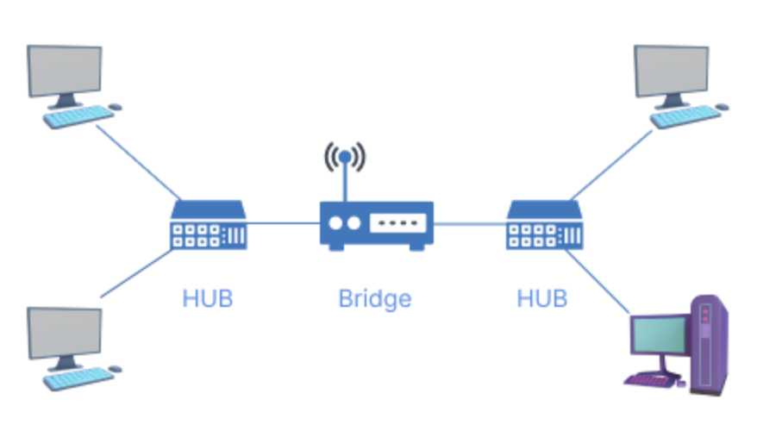
Bridge :
A bridge operates at the data link layer.
A bridge is a repeater, with add on the functionality of filtering content by reading the MAC addresses of the source and destination.
It is also used for interconnecting two LANs working on the same protocol.
It has a single input and single output port, thus making it a 2 port device.

Slide 9
Types of Bridges :
Transparent Bridges:- These are the bridge in which the stations are completely unaware of the bridge’s existence i.e. whether or not a bridge is added or deleted from the network, reconfiguration of the stations is unnecessary. These bridges make use of two processes i.e. bridge forwarding and bridge learning.
Source Routing Bridges:- In these bridges, routing operation is performed by the source station and the frame specifies which route to follow. The host can discover the frame by sending a special frame called the discovery frame, which spreads through the entire network using all possible paths to the destination.

Slide 10
Switch :
A switch is a multiport bridge with a buffer and a design that can boost its efficiency(a large number of ports imply less traffic) and performance.
The switch can perform error checking before forwarding data, which makes it very efficient as it does not forward packets that have errors and forward good packets selectively to the correct port only.
In other words, the switch divides the collision domain of hosts, but the broadcast domain remains the same.

Slide 11
Routers :
A router is a device like a switch that routes data packets based on their IP addresses.
Routers normally connect LANs and WANs and have a dynamically updating routing table based on which they make decisions on routing the data packets.
The router divides the broadcast domains of hosts connected through it.

Slide 12
Gateway:
A gateway, as the name suggests, is a passage to connect two networks that may work upon different networking models.
They work as messenger agents that take data from one system, interpret it, and transfer it to another system.
Gateways are also called protocol converters and can operate at any network layer.
Gateways are generally more complex than switches or routers. A gateway is also called a protocol converter.

Slide 13
NIC (network interface card):
NIC is a network adapter that is used to connect the computer to the network.
It is installed in the computer to establish a LAN.
It has a unique id that is written on the chip, and it has a connector to connect the cable to it.
The cable acts as an interface between the computer and the router or modem.

Slide 14
Protocols Standards
Protocols:
Some rules and procedures should be agreed upon at the sending and receiving ends of the system inorder to make a successful communication. Such rules and procedures are called as Protocols
Network protocol ensures that different technologies and components of the network are compatible with one another, reliable, and able to function together.

Slide 15
Key elements of Protocol:
Syntax :
Syntax refers to the structure or the format of the data that gets exchanged between the devices.
Syntax of message includes the type of data, composition of message and sequencing of message.
The starting 8 bits of data is considered as the address of the sender. The next 8 bits is considered to be the address of the receiver. The remaining bits are considered as the message itself.

Slide 16
Semantics :
Semantics defines data transmitted between devices.
It provides rules and norms for understanding message or data element values and actions.
Timing :
Timing refers to the synchronization and coordination between devices while transferring the data.
Timing ensures at what time data should be sent and how fast data can be sent.
Timing ensures preventing data loss, collisions

Slide 17
Sequence control :
Sequence control ensures the proper ordering of data packets.
The main responsibility of sequence control is to acknowledge the data while it get received, and the retransmission of lost data.
Through this mechanism the data is delivered in correct order.
Flow Control :
Flow control regulates device data delivery.
It limits the sender’s data or asks the receiver if it’s ready for more. Flow control prevents data congestion and loss.

Slide 18
Error Control :
Error control mechanisms detect and fix data transmission faults.
They include error detection codes, data resend, and error recovery.
Error control detects and corrects noise, interference, and other problems to maintain data integrity.
Security :
Network security safeguards data confidentiality, integrity, and authenticity, which includes encryption, authentication, access control, and other security procedures.
Network communication’s privacy and trustworthiness are protected by security standards.

Slide 19
Standards
Standards are the set of rules for data communication that are needed for exchange of information among devices.
It is important to follow Standards which are created by various Standard Organization like IEEE , ISO , ANSI etc
Standards are of two types :
De Facto Standard.
De Jure Standard.

Slide 20
De Facto Standard :
The meaning of the work ” De Facto ” is ” By Fact ” or “By Convention”.
These are the standards that have not been approved by any Organization, but have been adopted as Standards because of it’s widespread use.
Also , sometimes these standards are often established by Manufacturers.
For example : Apple and Google are two companies which established their own rules on their products which are different. Also they use some same standard rules for manufacturing for their products.

Slide 21
De Jure Standard :
The meaning of the word “De Jure” is “By Law” or “By Regulations”.
Thus , these are the standards that have been approved by officially recognized body like ANSI , ISO , IEEE etc.
These are the standard which are important to follow if it is required or needed.
For example : All the data communication standard protocols like SMTP , TCP , IP , UDP etc. are important to follow the same when we needed them.

Slide 22
Protocol and standard compliance: Protocol and standard compliance protects data, resources, and networks.
Interoperability : Protocols and standards allow devices and systems to communicate. These protocols ensure network components can function together, avoiding risks and security gaps produced by incompatible or unsupported systems.
Security Baseline : Protocols and standards contain security principles and best practices that help secure network infrastructure. These protocols allow organizations to protect sensitive data via encryption, authentication, and access controls.
Vulnerability Management : Network security protocols and standards help organizations find and fix vulnerabilities. Organizations can prevent cyberattacks and address vulnerabilities by following these compliance criteria.

